Slide 1
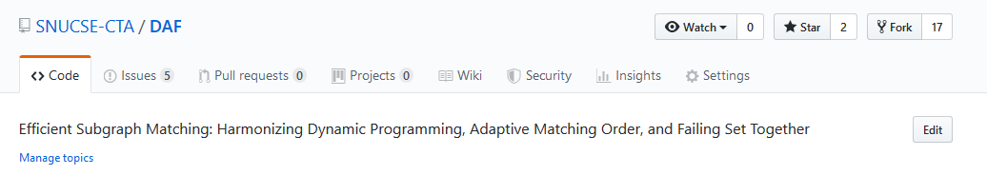
star
Issues

Slide 2
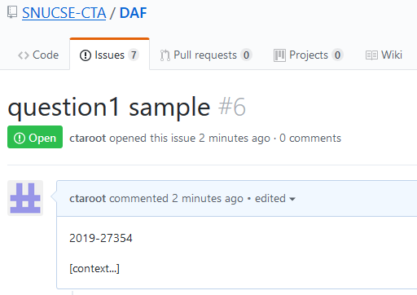
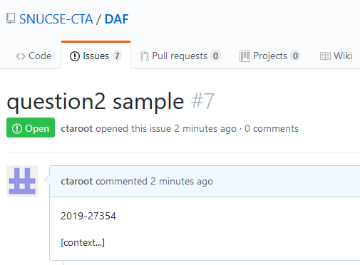
Send me a image of issue ( one image for one issue ).
There should be student number on issue.
( Student id of only one member of team is enough. )

Slide 3
Modified submission format.
Send me two images with your report and source file.
201927354.zip
->201927354
-->main.py
-->document.doc
-->images1.jpg
-->images2.jpg

